Slide 1


Future of Credentialing
Introducing foresight and change drivers
Community. Competence. Credibility.
credentialingexcellence.org

Slide 2
Tips for Making the Most of the Report
Future of Credentialing
Take steps to make the topics relevant and adapt the information to language that works for your situation.
Focus on taking action; it may take several times reading through the material before it becomes clear how to take the next steps.
Additional discovery will come through conversations.
As leaders, we should look for ways to bring the information to our constituents in a cohesive way.
Consider how to bring staff and board along for the journey.

Slide 3

Report Purpose and Goals
Future of Credentialing
To examine the external drivers of change impacting the credentialing field.
To provide a forward-looking perspective to ensure the credentialing industry remains relevant and viable in the next decade.
To assist credentialing bodies with seeing the future more clearly and to inspire their own forward-looking perspective
This project specifically supports I.C.E. Ends Statements:
3.1 Research advances the quality and value of credentialing.
6.1 Innovation is cultivated in the community and the organization

Slide 4
Who was involved in developing the report?
Future of Credentialing
An advisory group of I.C.E. member leaders
I.C.E. members and constituents
Professional futurists at Foresight Alliance
I.C.E. staff

Slide 5
Project Design
Future of Credentialing
Phase I – Framing. This phase focused on preliminary research, domain mapping of topics, framing up of the research, and incorporation of interviews.
Phase II – Research. This phase focused on the articulation of the key driver concepts to be developed through the research inventory to be discussed and evaluated by the Advisory Group with input from the Board of Directors.
Phase III – Writing. This phase included writing the report, creating the Take Action sections (written by the Advisory Group), and organizing the content into the final report.
Phase IV – Evaluation. A series of six focus groups involving more than forty I.C.E. members tested the concepts, created critical feedback on the paper, and provided recommendations for future refinement.

Slide 6
Change Driver Format
Future of Credentialing
Forecasts
Supporting Trends with Key Uncertainties and Notable Data Points
Strategic Insights with Potential Alternative Futures
Take Action Items with Topics for Additional Research

Slide 7
Audiences
Future of Credentialing
CEOs and C-suite level staff members of credentialing organizations
Executive directors or directors of programs, embedded in a larger membership organization, who are responsible for the strategic planning for credentialing programs
Members of strategic governing bodies of credentialing organizations
Consultants who work with strategic governing bodies on strategically thinking about the future

Slide 8
What is Foresight?
Future of Credentialing
Trends analysis is a valuable activity to increase awareness of one's environment. It is anchored in the present, and diminishes in value beyond the short term, as a trend is by definition happening now and in the past. Trends analysis indicates a potential trajectory for future change.
Foresight goes beyond trends to consider how they will develop, change, be reversed, or face discontinuities in the future, and how trends and other drivers will combine to create outcomes. Foresight takes on longer time horizons, and uses structured methodologies to explore multiple potential futures and the potential actions and strategies to achieve (or avoid) them.
Source: Foresight Alliance

Slide 9
What is Foresight?
Future of Credentialing
Foresight is a structured process for discerning, analyzing, and acting on potential futures. Foresight is a leadership competency with disciplined ways of thinking, a language, and processes that help followers envision the future and prepare to engage with it. Futures thinking is inquisitive, critical, and imaginative.
Source: ASAE ForesightWorks

Slide 10
Initiating and Integrating the Practice of Foresight
Future of Credentialing
How will we use the information in the change driver action briefs?
Who can help us carry the messages?
Where can we introduce foresight discussions into our routines?
Source: ASAE ForesightWorks

Slide 11
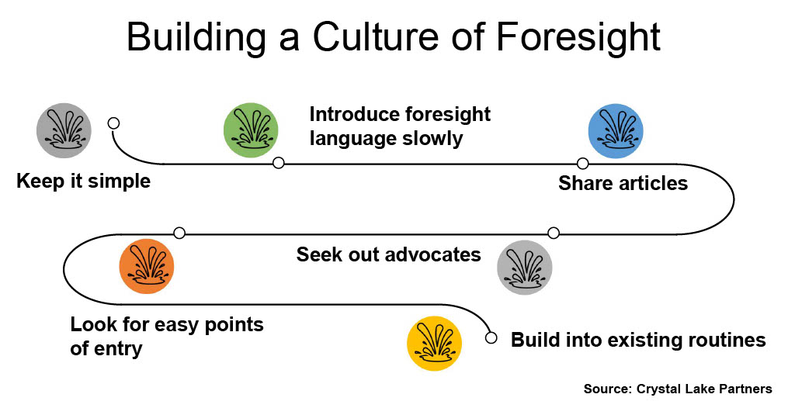
Future of Credentialing

Slide 12
Getting Started with the Change Drivers

Slide 13
Getting Started with the Change Drivers
Future of Credentialing
What lens or lenses should we use to assess the information?
In which order should we prioritize them?
Will we work with one, two, or all three of them?

Slide 14
Getting Started with the Change Drivers
Future of Credentialing
For change driver #1, what are the 5-10 most compelling data points with high relevancy or impact to our organization?
What do these mean for our organization?
How do these impact our strategic planning?
What are the practical, tangible steps we can take?
In which channels should we circulate this information throughout our organization?

Slide 15
Getting Started with the Change Drivers
Future of Credentialing
For change driver #2, what are the 5-10 most compelling data points with high relevancy or impact to our organization?
What do these mean for our organization?
How do these impact our strategic planning?
What are the practical, tangible steps we can take?
In which channels should we circulate this information throughout our organization?

Slide 16
Getting Started with the Change Drivers
Future of Credentialing
For change driver #3, what are the 5-10 most compelling data points with high relevancy or impact to our organization?
What do these mean for our organization?
How do these impact our strategic planning?
What are the practical, tangible steps we can take?
In which channels should we circulate this information throughout our organization?

Slide 17
Questions to spark foresight conversations
Future of Credentialing
What does the change driver mean for our organization?
What does the change driver mean for our members and constituents?
What does the change driver mean for the environment in which we work?
What are the opportunities and risks associate with the change driver?
What elements of the change driver do we need to learn more about?

Slide 18
Questions to spark foresight conversations
Future of Credentialing
What additional questions should we be asking about the change driver?
How quickly do we anticipate the change driver impacting our organization?
What steps do we need to take now to make the most of the change driver?
What is our plan to continue monitoring the change driver in the coming months and years?

Slide 19
Overcoming Resistance

Slide 20
Overcoming Resistance
HEADER SHOWN REFERENCE
Objection
Counter
I like how things are now. I don’t want to change.
Change is going to happen so let’s identify the core values we want to maintain as processes.
Adapted from ASAE ForesightWorks Users Guide

Slide 21
Overcoming Resistance
HEADER SHOWN REFERENCE
Objection
Counter
Those changes are not really going to happen.
Here’s a concrete example of how that change could impact our organization.
Adapted from ASAE ForesightWorks Users Guide

Slide 22
Overcoming Resistance
HEADER SHOWN REFERENCE
Objection
Counter
The next set of leaders will need to address those changes after I retire.
A good leader sets up an environment of success for those who follow next.
Adapted from ASAE ForesightWorks Users Guide

Slide 23
Overcoming Resistance
HEADER SHOWN REFERENCE
Objection
Counter
We are not very strategic.
It takes time to become strategic. The tools and resources in this guide can help.
Adapted from ASAE ForesightWorks Users Guide

Slide 24
Overcoming Resistance
HEADER SHOWN REFERENCE
Objection
Counter
We are too busy and cannot add one more thing to our plates.
Focusing on the future helps to prioritize our work and creates space to jettison outdated activities.
Adapted from ASAE ForesightWorks Users Guide

Slide 25
Key Messages for Specific Audiences

Slide 26
For CEOs and C-suite Staff
Future of Credentialing
While we serve as change agents, we should engage our board, volunteer leaders, and staff in the practice of foresight.
Look for ways to weave foresight into our board orientation, board reports, and board conversations.
Foresight applies to all functional and programmatic areas. Include future-oriented language in our regular reports.
Use the data to justify sunsetting or continuing existing programs or developing something new.

Slide 27
For Credential Program Directors
Future of Credentialing
Look for opportunities to introduce the practice of foresight both up and down the organization.
Consider how the emerging changes may impact your credentialing program.
Use the data in the change drivers to become a subject matter expert and change agent.
Use the change drivers to provide direction for your credentialing program.

Slide 28
For Volunteer Leaders
Future of Credentialing
Use the information in the change drivers to shift from a reactive to a proactive mindset.
Incorporate foresight into your strategic planning activities.
Consider how to incorporate future-oriented discussions in meeting agenda and strategic conversations.
Make those conversations concrete by exploring various future scenarios.

Slide 29
For Consultants
Future of Credentialing
Become a foresight champion for the credentialing community.
Look for opportunities to include foresight concepts in your marketing communications and thought pieces.
Serve as a trusted third party to help your clients accept the change driver concepts.
Help your clients apply the change driver themes to their setting.
Use the change drivers to structure client discussion on their vision and strategy.

Slide 30
Change Driver Talking Points

Slide 31

Takeaways…
Topic: Credentials Under Pressure
What is measured and how?
Education ferment
Proliferation of credentials
DEI impacts (and opportunities)
Tightening demand for skilled workers

Slide 32
Take Action: Credentials Under Pressure
Take Action
Focus on governments and educators as partners in the future, not as adversaries.
Let go of legacy approaches of right and wrong or good and bad in the credentialing industry. Take a leadership role in developing new alternative credentialing models that may challenge the status quo.
Cultivate an organizational commitment to establishing DEI strategies that will advance the participation of underrepresented credential holders.
Assess the opportunity to develop microcredentials to address new trends.
Reimagine entry-level and ongoing eligibility requirements and consider experiential learning and/or microcredentials as a means of meeting these criteria.
Be vigilant about your organization’s authority, brand reputation and voice in its industry and/or profession. Strengthen your brand reputation and your credentialing programs’ credibility.

Slide 33

Takeaways…
Topic: Government and Credentialing
Role changes for government
Pushback on licensing
Impacts of polarization
Views of government
Credentialing divides

Slide 34
Take Action
Take Action: Government and Credentialing
Become a trusted voice through more investment in government relations and public policy.
Partner with the industry/profession at both federal and state levels for combined advocacy on the value and importance of legitimate credentials and the nonpartisan nature and importance of public protection.
Initiate and promote research on the value of your credential(s).
Join forces with other credentialing organizations to keep a pulse on state, federal and global proceedings that may affect the credentialing industry and/or lead change.
Leverage the collective power of industry to organize strategic approaches to government actions.
Invest in efforts and initiatives (i.e., research, communication campaigns, etc.) that increase the perceived value of your credential(s) among all stakeholders

Slide 35

Takeaways…
Topic: Technology Innovation
AI and its effects
Data and monitoring
Evaluating complex and non-cognitive skills
Transparency and portability
Blockchain’s use for credentialing portability
Digital accessibility

Slide 36
Take Action
Take Action: Technology Innovation
Rethink legacy approaches to credentialing and testing. Invest in innovation to develop newer, faster, more seamless solutions.
Collaborate with technology providers that work to enhance knowledge and skill acquisition associated with practice.
Invest in technology to enhance business operations, efficiency and service delivery.
Continuously scan the environment for emerging technologies.
Regularly explore the implications of new capabilities such as blockchain, clarify their utility and educate stakeholders on how they might use them.

